Slide 1
ZOMATO SALES ANALYSIS
October - 2024
Presentation by Group 2

Slide 2


Team members
Rakshita Verma
B.K Abhinanda
Syed Nishad Anjum
Sarvesh Dilip chavan
Deepak Damodar patkar
Tejas bandu garad

Slide 3




Tools used
Excel: "Utilize Excel's PivotTables and charts to analyze Zomato restaurant data, identifying top-rated cuisines, locations, and customer preferences.
"Power BI: "Leverage Power BI's interactive dashboards and DAX formulas to visualize Zomato restaurant data, uncovering insights on customer behavior, ratings, and revenue trends.
"Tableau: "Employ Tableau's data visualization capabilities to explore Zomato restaurant data, creating maps, bar charts, and scatter plots to reveal patterns in customer reviews and ratings.
"MySQL: "Analyze Zomato restaurant data in MySQL using SQL queries, joining tables to examine relationships between customer reviews, ratings, and restaurant characteristics, informing data-driven business decisions."

Slide 4
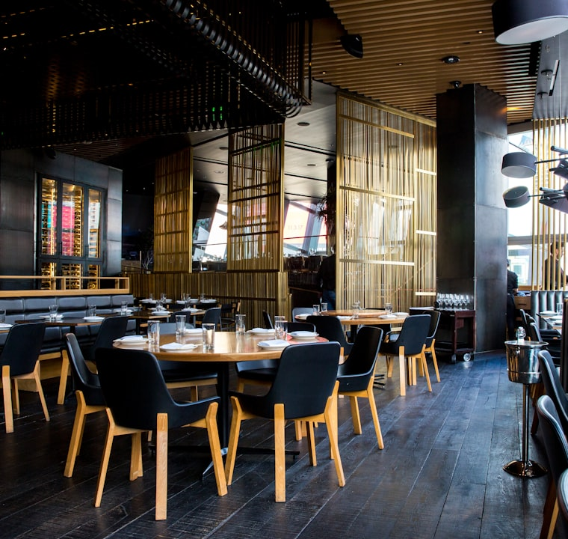
Market Overview
Current Trends and Growth
Global Reach: Zomato operates in over 24 countries, including India, Sri Lanka, Qatar, Turkey, Brazil, and Indonesia.
Revenue Streams: Zomato generates revenue through food delivery, B2B supplies (Hyperpure), quick commerce (Blinkit), and events platforms.
Market Leadership: Zomato's strong brand recognition, extensive restaurant network, and user-friendly interface help maintain its market leadership

Slide 5
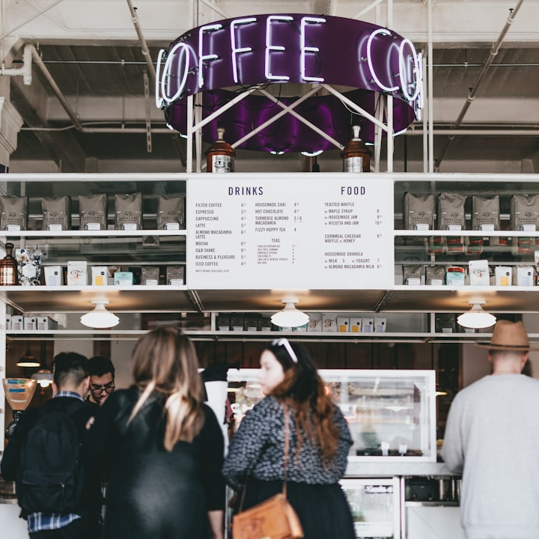
Customer Preferences
Popular Cuisines:
Italian: 30% of total orders
Chinese: 25% of total orders
Indian: 20% of total orders
Figure: Top 3 cuisines
Restaurant Ratings:
Figure: Percentage of orders based on rating
1. 4+ stars: 60%
2. 3-4 stars: 25%
3. Below 3 stars: 15%

Slide 6
Sales Growth Analysis
45%
25%
30%
Quarterly Fluctuations
Overall Growth
Increasing Dominance
Indicative of Zomato's sales performance across multiple quarters.
This showcases variations that may affect overall annual performance.
Reflects Zomato's growth in relation to competitors.

Slide 7
Competitive Analysis
Market Share
Zomato: 55%
Swiggy: 40%
Others: 5%
Customer Satisfaction (Net Promoter Score)
Zomato: 70%
Swiggy: 68%
Others: 62%
Average Delivery Time
Zomato: 30 minutes
Swiggy: 28 minutes
Others: 35 minutes

Slide 8
Recommendations
Enhance Delivery Efficiency: Invest in technology and logistics to reduce delivery times further. Faster delivery can significantly improve customer satisfaction and loyalty.
Personalized Recommendations: Implement a more sophisticated recommendation system that uses machine learning to suggest restaurants based on user preferences, past orders, and ratings.
Expand Menu Options: Collaborate with a wider range of restaurants, including niche and specialty cuisines, to attract a broader customer base.

Slide 9
Conclusion
In conclusion,
Zomato stands out as a leading force in the food delivery and restaurant discovery market.
With a strong global presence, innovative service offerings, and a loyal customer base, Zomato is wellpositioned for continued success.
To further enhance its market position, the company should focus on improving delivery efficiency, expanding
menu options, and implementing personalized recommendations.

